Slide 1
Testing
EPFL Software Engineering

Slide 2
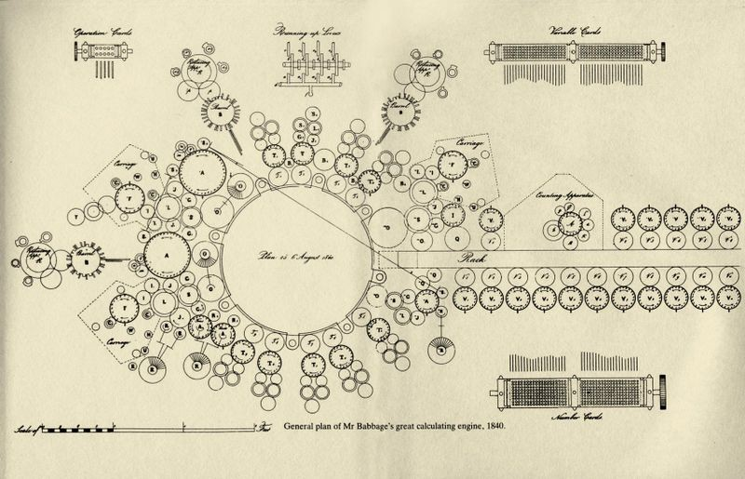
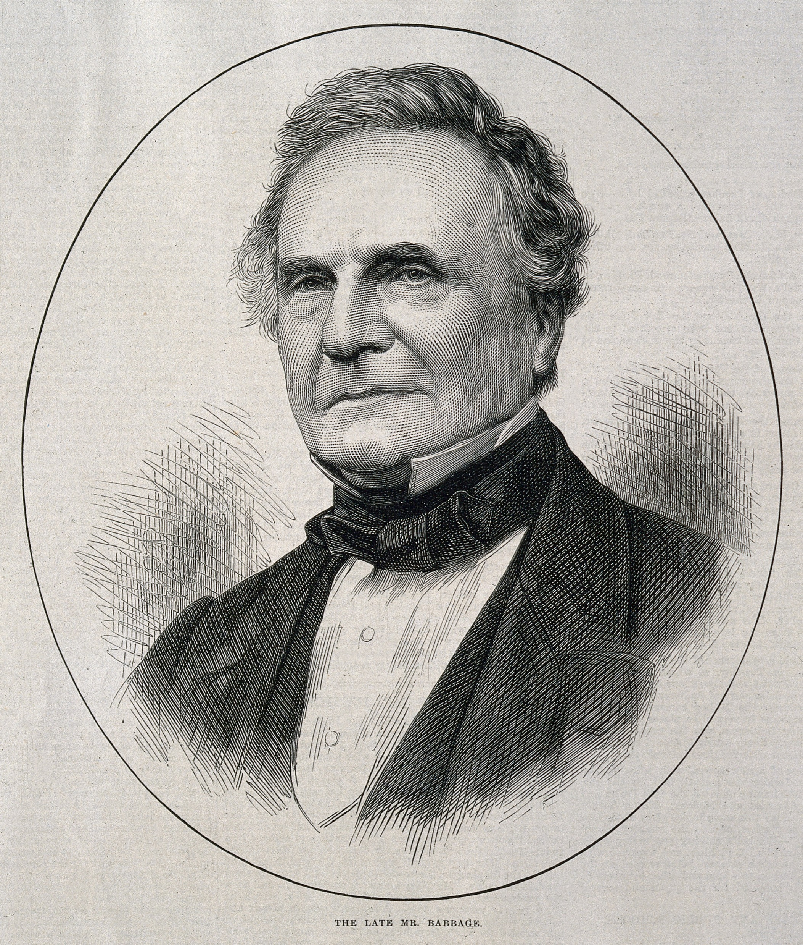
The Analytical Engine, “Plan 25” (Computer History Museum) ; Charles Babbage, wood engraving, 1871 (Wikipedia)

Slide 3
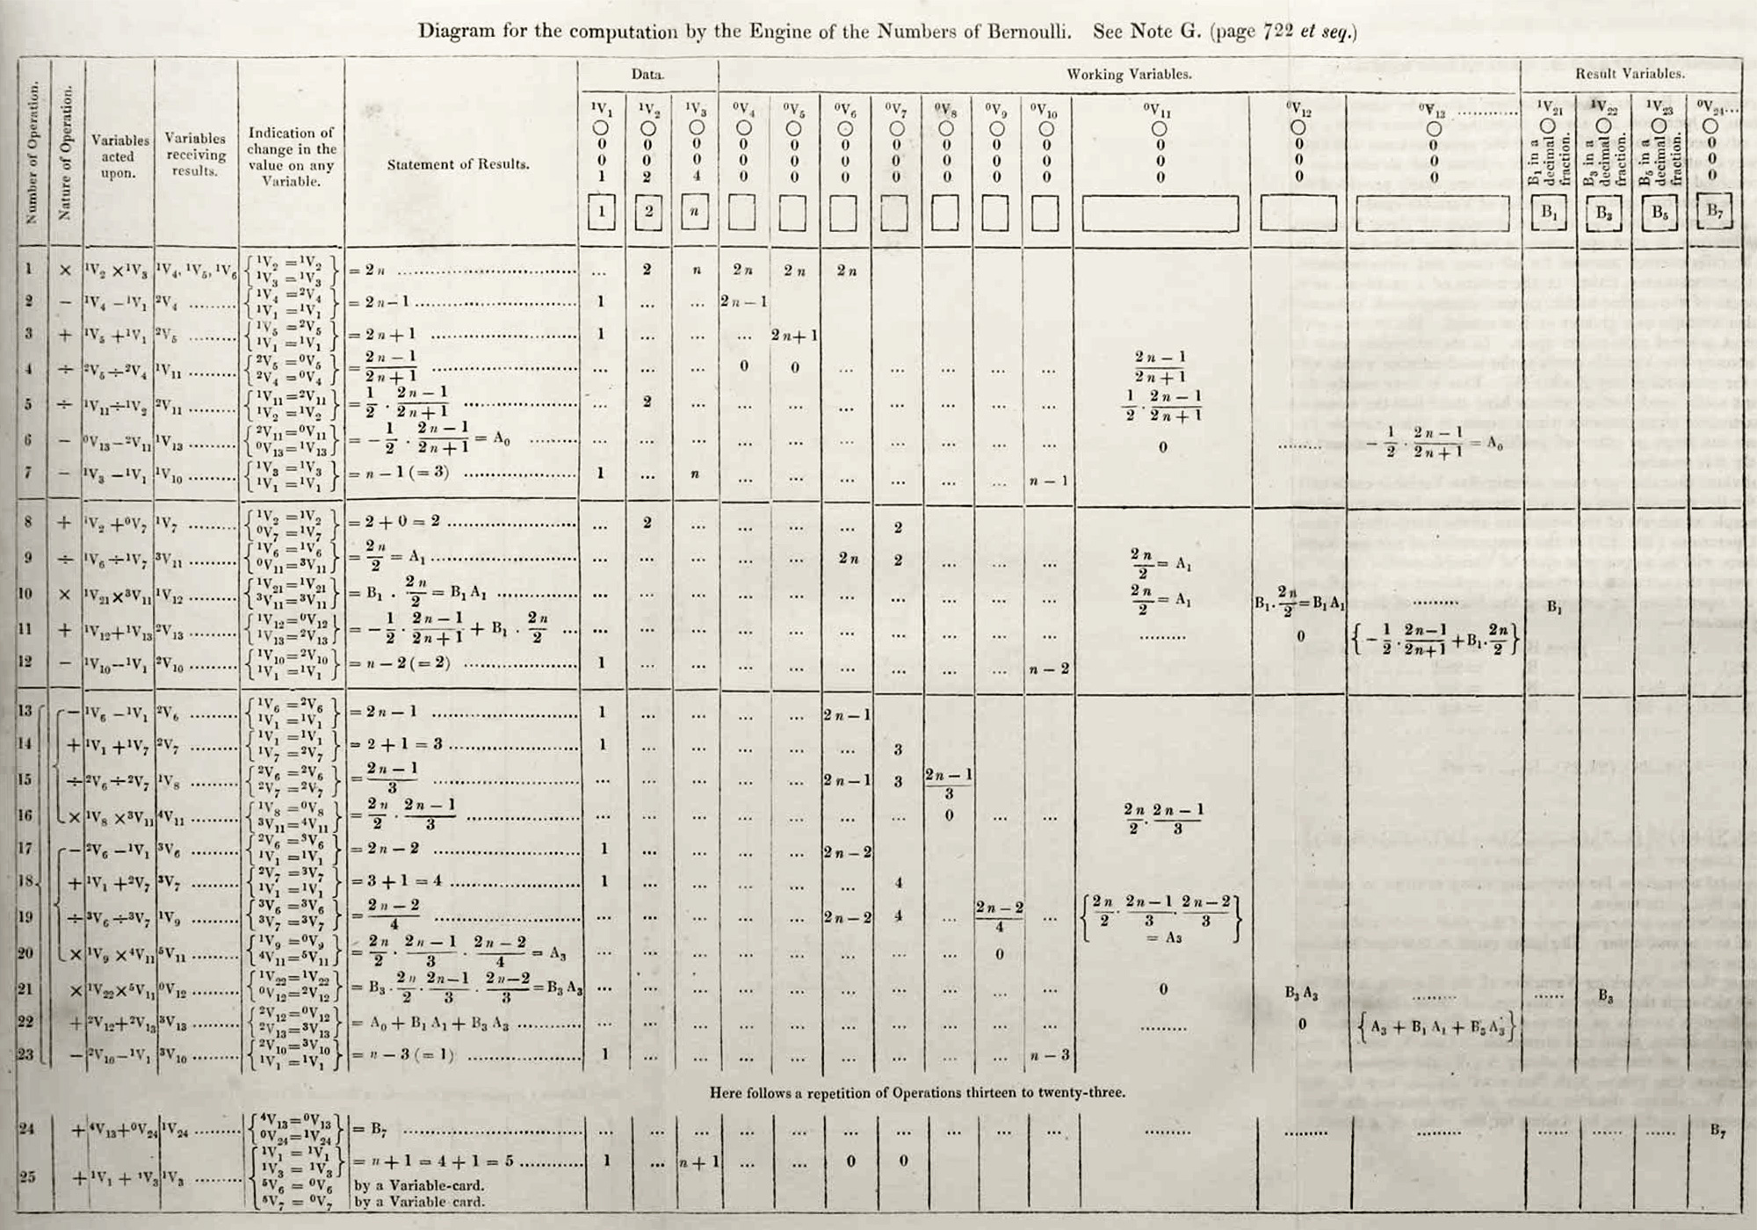
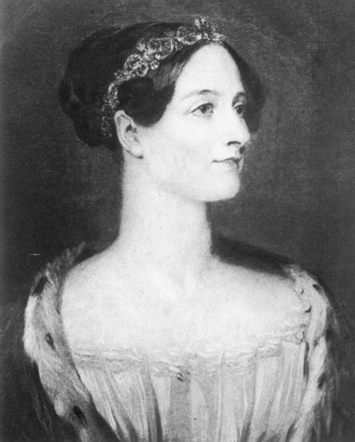
Ada Lovelace, portrait, 1840 (Wikipedia)

Slide 4

Verification?
10k lines of code
200k lines of proof
seL4: formal verification of an OS kernel, G. Klein et al., 2009

Slide 5

Beta versions?
“the most notable bug [...] forces you to wait 7 days to respawn”
“New World’s Bugs and Glitches Are Almost as Bad as Cyberpunk 2077”, Den of Geek, 2021

Slide 6

How bad is a bug?

Slide 7


Slide 8
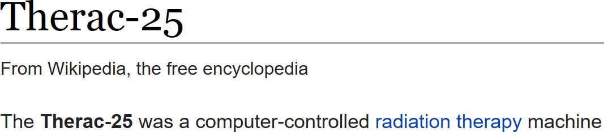
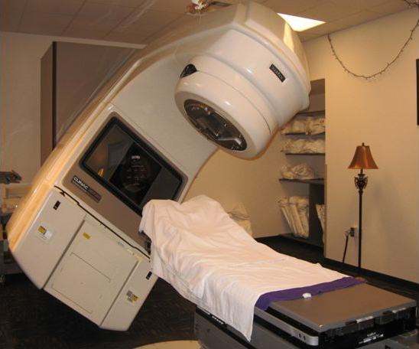

Slide 9
Objectives
Understand the basics of automated testing
Evaluate tests with code coverage
Identify when to write which tests
Adapt code to enable fine-grained testing

Slide 10
What is a test?

Slide 11
Test
Set up
Do something
Check the result

Slide 12

“Program testing can be used
to show the presence of bugs,
but never to show their absence!”
Edsger W. Dijkstra
"Notes On Structured Programming" (EWD249)

Slide 13
Manual testing?
Slow
Error-prone
Ill-defined criteria
Hard to test edge cases

Slide 14
Edge cases
“Between 2 and 3am...”
“For Basque users...”
“If the disk is full...”

Slide 15
Automated test
Code to set up “Arrange”
Code to do something “Act”
Code to check the result “Assert”

Slide 16
Test kinds
“Unit”
“Integration”
“End-to-end”
...

Slide 17

Write once, run many times
“CommonMark” standard: 652 tests
https://spec.commonmark.org/0.30/spec.json

Slide 18
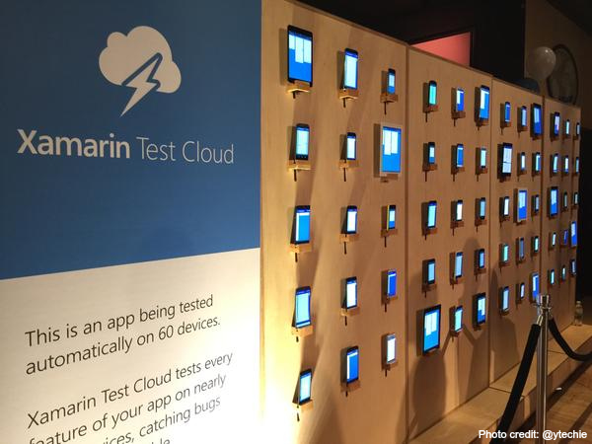

Slide 19

“The SQLite library consists of approximately 145.3 KSLOC [...]
By comparison, the project has 608 times as much test code and test scripts – 92038.3 KSLOC”
https://sqlite.org/testing.html

Slide 20
How does one write automated tests in Java?

Slide 21


Key idea
Test = method
Failure = exception
Success = no exception

Slide 22
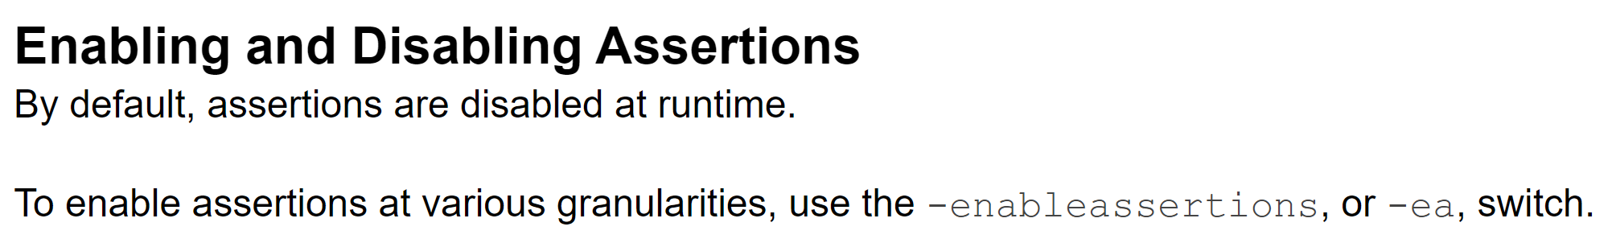
Example?
void test1plus1() {
assert add(1, 1) == 2;
}
https://docs.oracle.com/javase/7/docs/technotes/guides/language/assert.html

Slide 23
Example?
void test1plus1() {
if (add(1, 1) != 2) {
throw new AssertionError();
}
}

Slide 24
JUnit
import static org.junit.jupiter.api...; import org.junit.jupiter.api.Test;
@Test
void test1plus1() {
assertEquals(add(1, 1), 2);
}
?

Slide 25
JUnit + Hamcrest
import static org.hamcrest...;
@Test
void test1plus1() {
assertThat(add(1, 1), is(2));
}

Slide 26
Hamcrest matchers
List<Integer> values = ...;
assertThat(values,
either(empty())
.or(contains(1, 2, 3)));

Slide 27
Hamcrest messages
Expected: (an empty collection
or iterable containing [<1>, <2>, <3>])
but: was <[42]>

Slide 28
Expecting exceptions
var ex = assertThrows(
SomeException.class,
() -> someOperation(42)
);
// ... test 'ex'...

Slide 29
Exercise
Test Functions.java
First step: Test fibonacci for valid inputs
Notes:
7min til next

Slide 30
Example tests
@Test void fibonacci1Is1() {
assertThat(fibonacci(1), is(1));
}
@Test void fibonacci10Is55() {
assertThat(fibonacci(10), is(55));
}
Notes:
Try an invalid input for Fibonacci; 3min til next

Slide 31
@Test void fibonacciMinusOneThrows() {
assertThrows( IllegalArgumentException.class, () -> fibonacci(-1) );
}
Notes:
Now test split, you might need to look up a matcher; 3min

Slide 32
@Test void splitWithMiddleSeparator() {
assertThat( splitString("a b", ' '), contains("a", "b") );
}
Notes:
Now you can try shuffle; 2min

Slide 33
Example: Shuffle
// Arrange var vals = new String[]{"a", "b", "c"};
// Act shuffle(vals);
// Assert assertThat(vals, arrayContainingInAnyOrder("a", "b", "c"));

Slide 34
Test, test, test
Get used to it!

Slide 35
Grouping assertions
@Test void testFib() {
assertThat(fib(0), is(0));
assertThat(fib(1), is(1));
}

Slide 36
@Test void testZero() {
assertThat(fib(0), is(0));
}
@Test void testOne() {
assertThat(fib(1), is(1));
}

Slide 37
Test results
testEverything()

Slide 38
ageCannotBeLessThan0()
usersUnder18AreMinors()
birthDatePrintedWithUserLocale()
ageIsCorrectInLeapYear()

Slide 39
Sharing code
@BeforeAll static void globalSetup() {...}
@AfterAll static void globalTeardown() {...}
@BeforeEach void localSetup() {...}
@AfterEach void localTeardown() {...}

Slide 40
Naming tests
dateIsPrintedCorrectly
nameCanIncludeThaiCharacters
shareFeatureWorks
canParseNumbersOver1000

Slide 41
Naming: avoid...
“correctly”
“works”
“valid”
...

Slide 42
Testing private methods
DON’T

Slide 43
Imagine...
“The SQLite library consists of approximately 145.3 KSLOC [...]
By comparison, the project has 608 times as much test code and test scripts – 92038.3 KSLOC”
https://sqlite.org/testing.html

Slide 44
Test code is code
Standards
Quality
Version control

Slide 45
What metric can one use to evaluate tests?

Slide 46
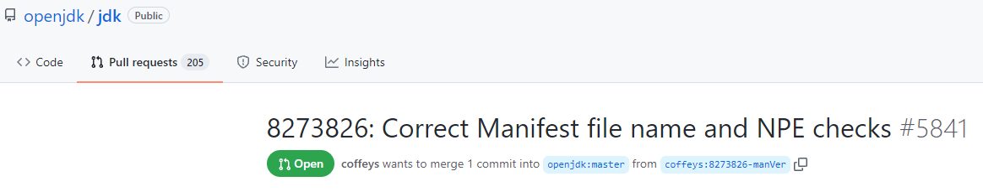
https://github.com/openjdk/jdk/pull/5841

Slide 47
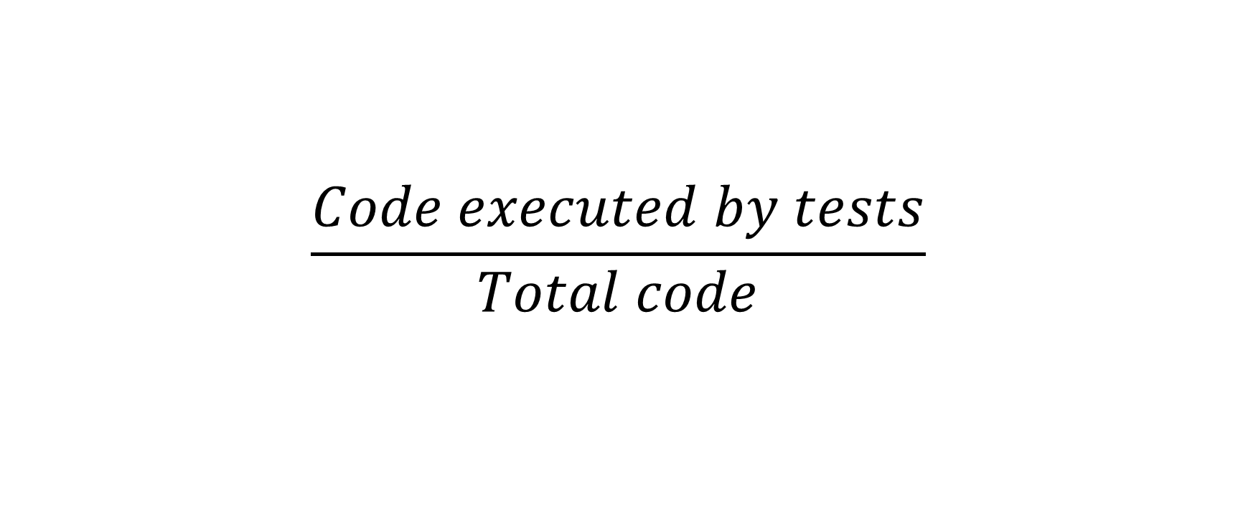
Coverage
$$\frac{Code executed by tests}{Total code}$$

Slide 48
“Code”
Lines?
Statements?
Branches?

Slide 49
Coverage example
int getFee(Package pkg) {
if (pkg == null) throw ...;
int fee = 10;
if (pkg.isHeavy()) fee += 10;
if (pkg.isInternational()) fee *= 2;
return fee;
}

Slide 50
Lines?
Heavy? | Int’l?
True | True
if (pkg == null) throw ...;
int fee = 10;
if (pkg.isHeavy()) fee += 10;
if (pkg.isInternational()) fee *= 2;
return fee;

Slide 51

if (pkg == null) throw ...;
int fee = 10;
if (pkg.isHeavy()) fee += 10;
if (pkg.isInternational()) fee *= 2;
return fee;

Slide 52
Statements?
Heavy? | Int’l?
True | True
if (pkg == null) throw ...;
int fee = 10;
if (pkg.isHeavy()) fee += 10;
if (pkg.isInternational()) fee *= 2;
return fee;

Slide 53
if (pkg == null) throw ...;
int fee = 10;
if (pkg.isHeavy()) fee += 10;
if (pkg.isInternational()) fee *= 2;
return fee;

Slide 54
Branches?
Heavy? | Int’l?
True | True
if (pkg == null) throw ...;
int fee = 10;
if (pkg.isHeavy()) fee += 10;
if (pkg.isInternational()) fee *= 2;
return fee;

Slide 55
if (pkg == null) throw ...;
int fee = 10;
if (pkg.isHeavy()) fee += 10;
if (pkg.isInternational()) fee *= 2;
return fee;

Slide 56
Heavy? | Int’l?
True | True
False | False
null
if (pkg == null) throw ...;
int fee = 10;
if (pkg.isHeavy()) fee += 10;
if (pkg.isInternational()) fee *= 2;
return fee;

Slide 57


if (pkg == null) throw ...;
int fee = 10;
if (pkg.isHeavy()) fee += 10;
if (pkg.isInternational()) fee *= 2;
return fee;

Slide 58
Paths
40
throw
int’l?
20
null?
heavy?
20
int’l?
10

Slide 59
Paths
Heavy? | Int’l?
True | True
False | False
null
if (pkg == null) throw ...;
int fee = 10;
if (pkg.isHeavy()) fee += 10;
if (pkg.isInternational()) fee *= 2;
return fee;

Slide 60
if (pkg == null) throw ...;
int fee = 10;
if (pkg.isHeavy()) fee += 10;
if (pkg.isInternational()) fee *= 2;
return fee;

Slide 61
Heavy? | Int’l?
True | True
False | False
null
True | False
False | True
if (pkg == null) throw ...;
int fee = 10;
if (pkg.isHeavy()) fee += 10;
if (pkg.isInternational()) fee *= 2;
return fee;

Slide 62

if (pkg == null) throw ...;
int fee = 10;
if (pkg.isHeavy()) fee += 10;
if (pkg.isInternational()) fee *= 2;
return fee;

Slide 63
How many paths?
if (...) { ... }
if (...) { ... }
if (...) { ... }
if (...) { ... }
if (...) { ... }

Slide 64
Max path coverage?
while (true) {
var input = getUserInput();
if (input.length() <= 10) break;
tellUser("No more than 10 chars");
}

Slide 65
Coverage tradeoff
Feasibility Confidence
Paths
Statements
Branches

Slide 66
“Coverage”
@Test void coverCode() {
getFee(new Package(...));
getFee(new Package(...));
getFee(new Package(...));
}

Slide 67
Exercise
Run your previous tests,
with coverage
Notes:
5min (they do not need to write new code)

Slide 68
When to test?

Slide 69



Afterward?

Slide 70
Development cycle
Dev
Release
Test?

Slide 71
“Test-Driven Development”
Dev
Release
Test

Slide 72
“TDD”
Write tests
Write code
Fix code

Slide 73
Why?
Think before coding
Instant feedback

Slide 74
Why not?
Takes more time
Needs up-front design

Slide 75
Example
“Clients can withdraw money from their bank account.”

Slide 76
“Can a client have a balance below 0?”
“No.”

Slide 77
Test
@Test void canWithdrawNothing() {
var account = new Account(100);
assertThat(account.withdraw(0), is(0));
}

Slide 78
Skeleton
class Account {
Account(int balance) { }
int withdraw(int amount) { throw ...; }
}

Slide 79
Test
@Test void noInitWithBalanceBelow0() {
assertThrows( IllegalArgumentException.class, () -> new Account(-1) );
}

Slide 80
Test
@Test void canWithdrawLessThanBalance() {
var account = new Account(100);
assertThat(account.withdraw(10), is(10));
assertThat(account.balance(), is(90));
}

Slide 81
Skeleton
class Account {
Account(int balance) { }
int withdraw(int amount) { throw ...; }
int balance() { throw ...; }
}

Slide 82
Test
@Test void partialWithdrawIfLowBalance() {
var account = new Account(10);
assertThat(account.withdraw(20), is(10));
assertThat(account.balance(), is(0));
}

Slide 83
canWithdrawNothing()
noInitWithBalanceBelow0()
canWithdrawLessThanBalance()
partialWithdrawIfLowBalance()

Slide 84
Implementation
int balance;
int balance() { return balance; }

Slide 85
Account(int balance) {
if (balance < 0) { throw new IllegalArgumentException(); }
this.balance = balance;
}

Slide 86
int withdraw(int amount) {
int result = Math.max(balance, amount);
balance -= result;
return result;
}
min

Slide 87
“We forgot!
Accounts can be blocked.
Withdrawing from a blocked account has no effect.”

Slide 88
TDD loop
Requirements
Code
Tests

Slide 89
Exercise
TDD for PeopleCounter.java
First step: Write tests!
Notes:
6min til next

Slide 90
Test ideas
Starts at 0
+1 increments count
Reset sets count to 0
Cannot exceed max
Max cannot be <0
Notes:
6min til next

Slide 91
Regression testing
Dev
Release
Test

Slide 92

Why?
Prevent old bugs from coming back!

Slide 93
Regression test
Reproduce the bug with a failing test
Fix the bug
Confirm the fix with the test

Slide 94
More tests, fewer bugs
“The SQLite library consists of approximately 145.3 KSLOC [...]
By comparison, the project has 608 times as much test code and test scripts – 92038.3 KSLOC”
https://sqlite.org/testing.html

Slide 95
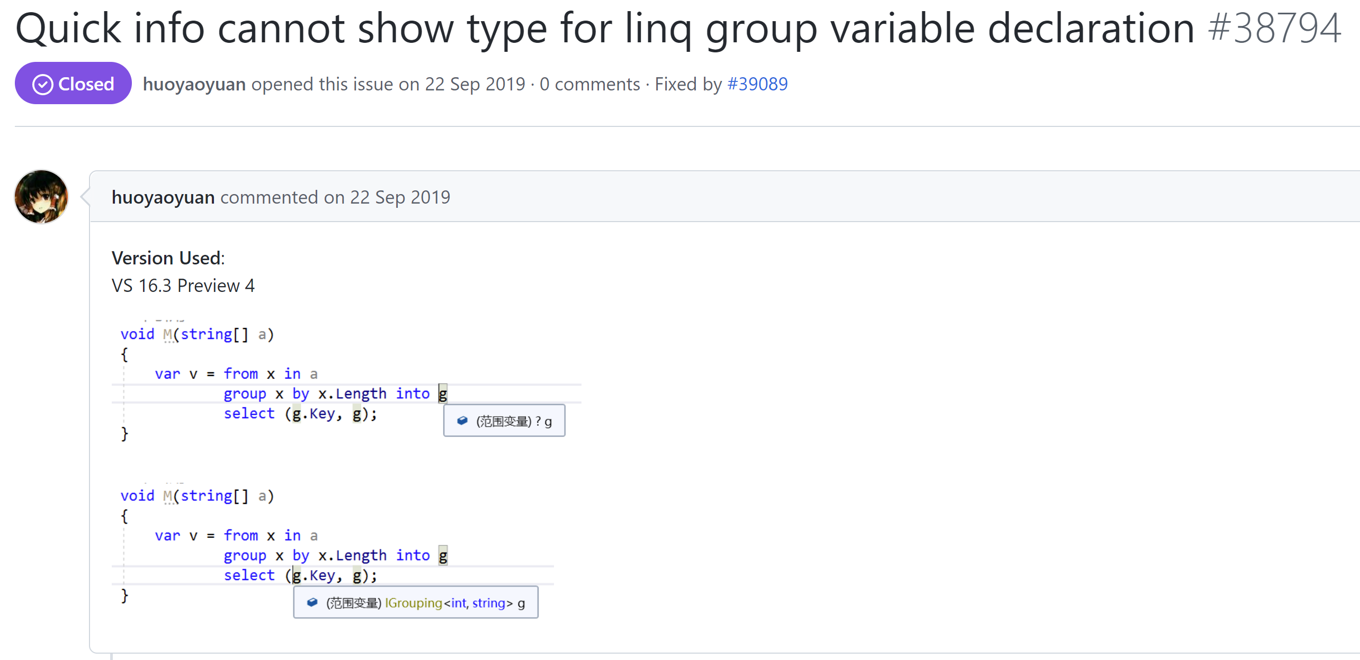
Example
https://github.com/dotnet/roslyn/issues/38794

Slide 96
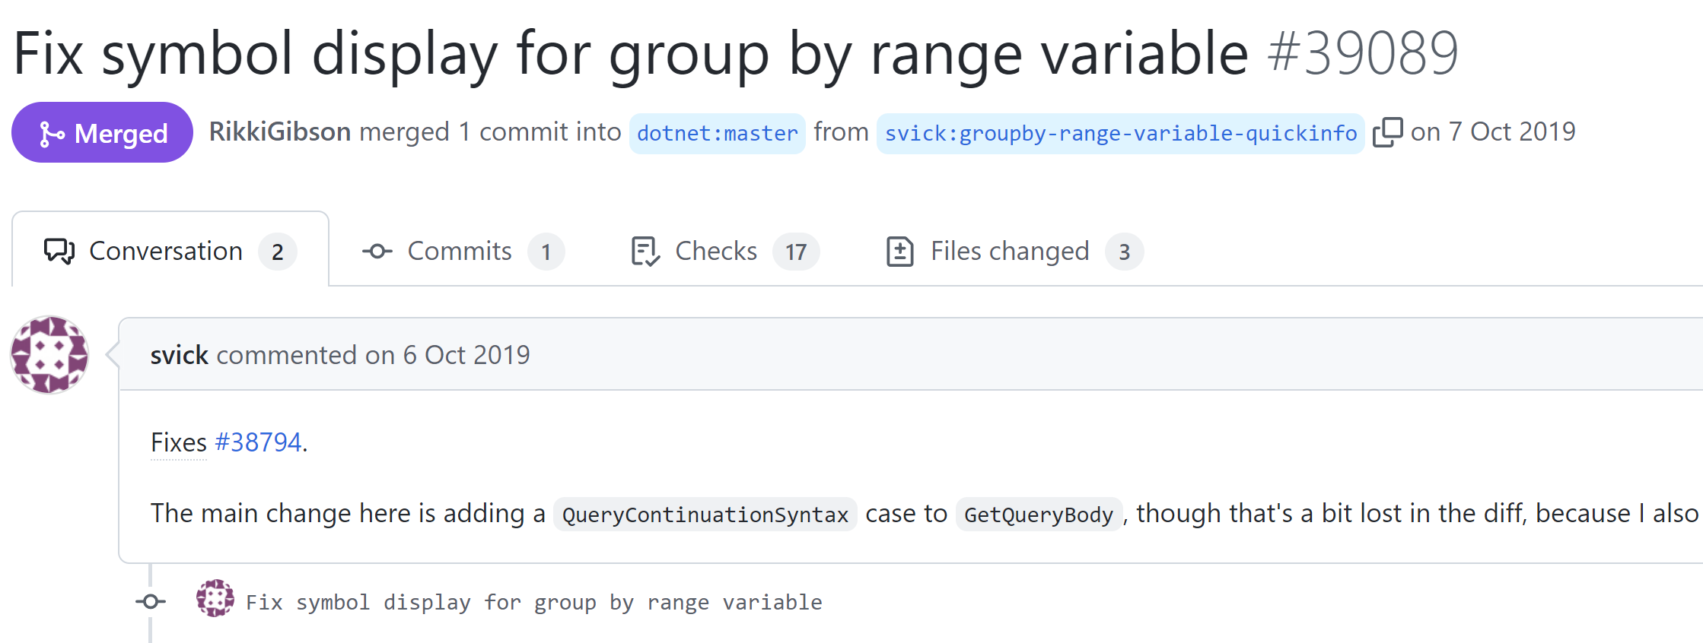
https://github.com/dotnet/roslyn/pull/39089

Slide 97
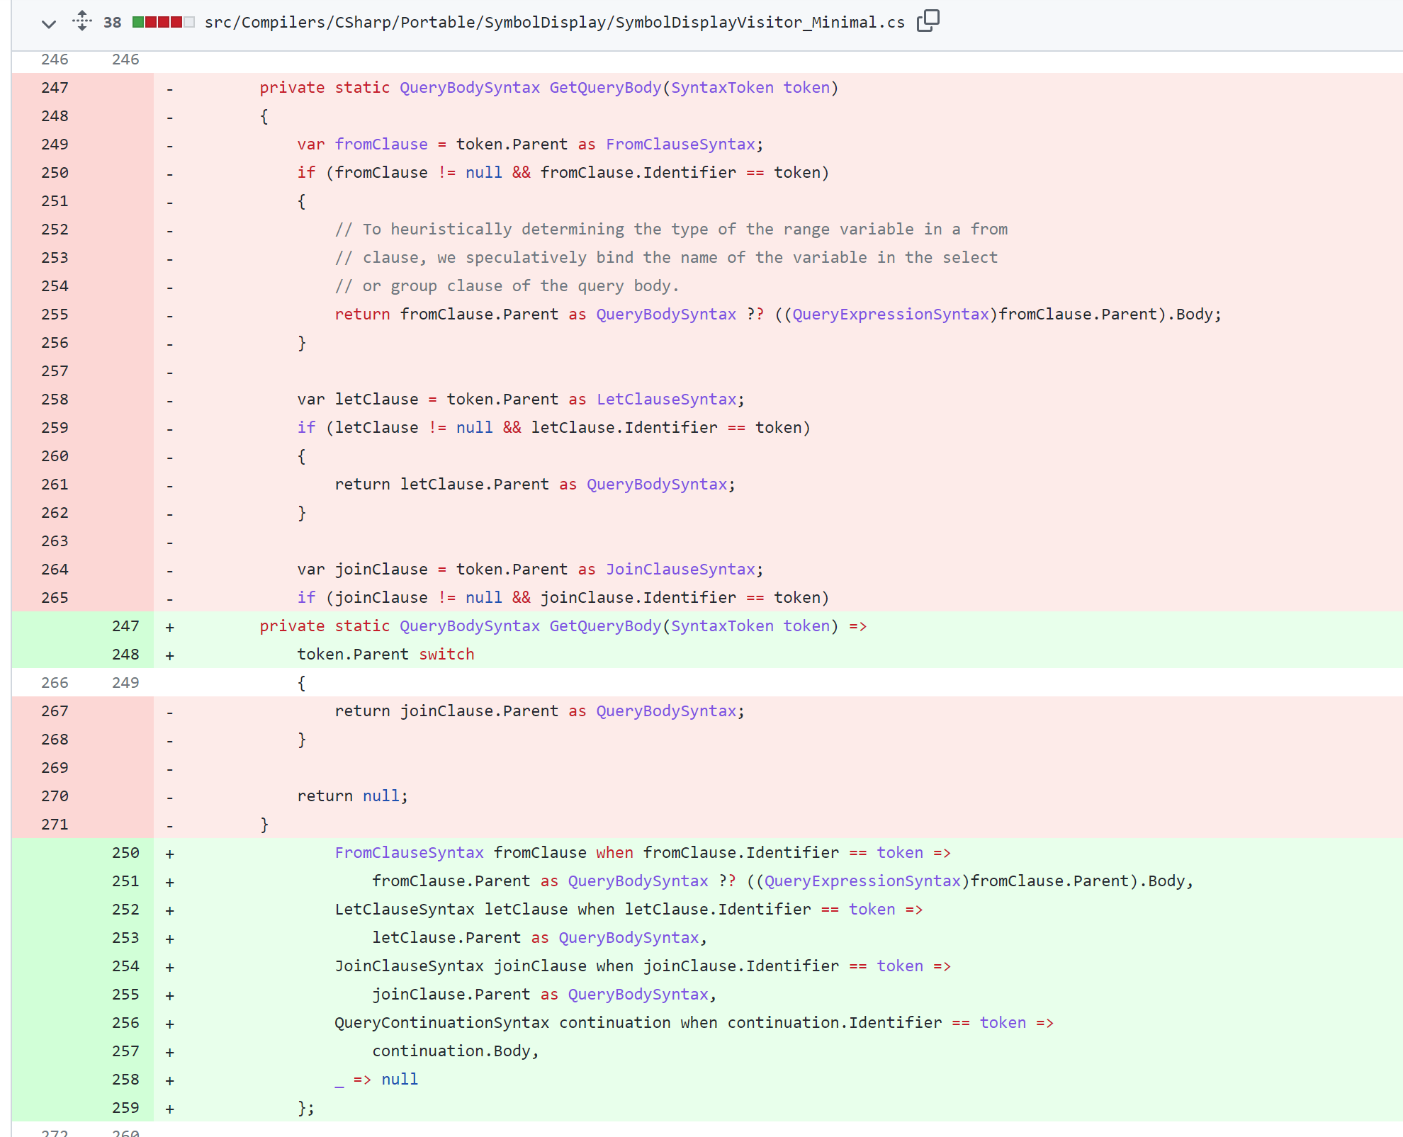

Slide 98
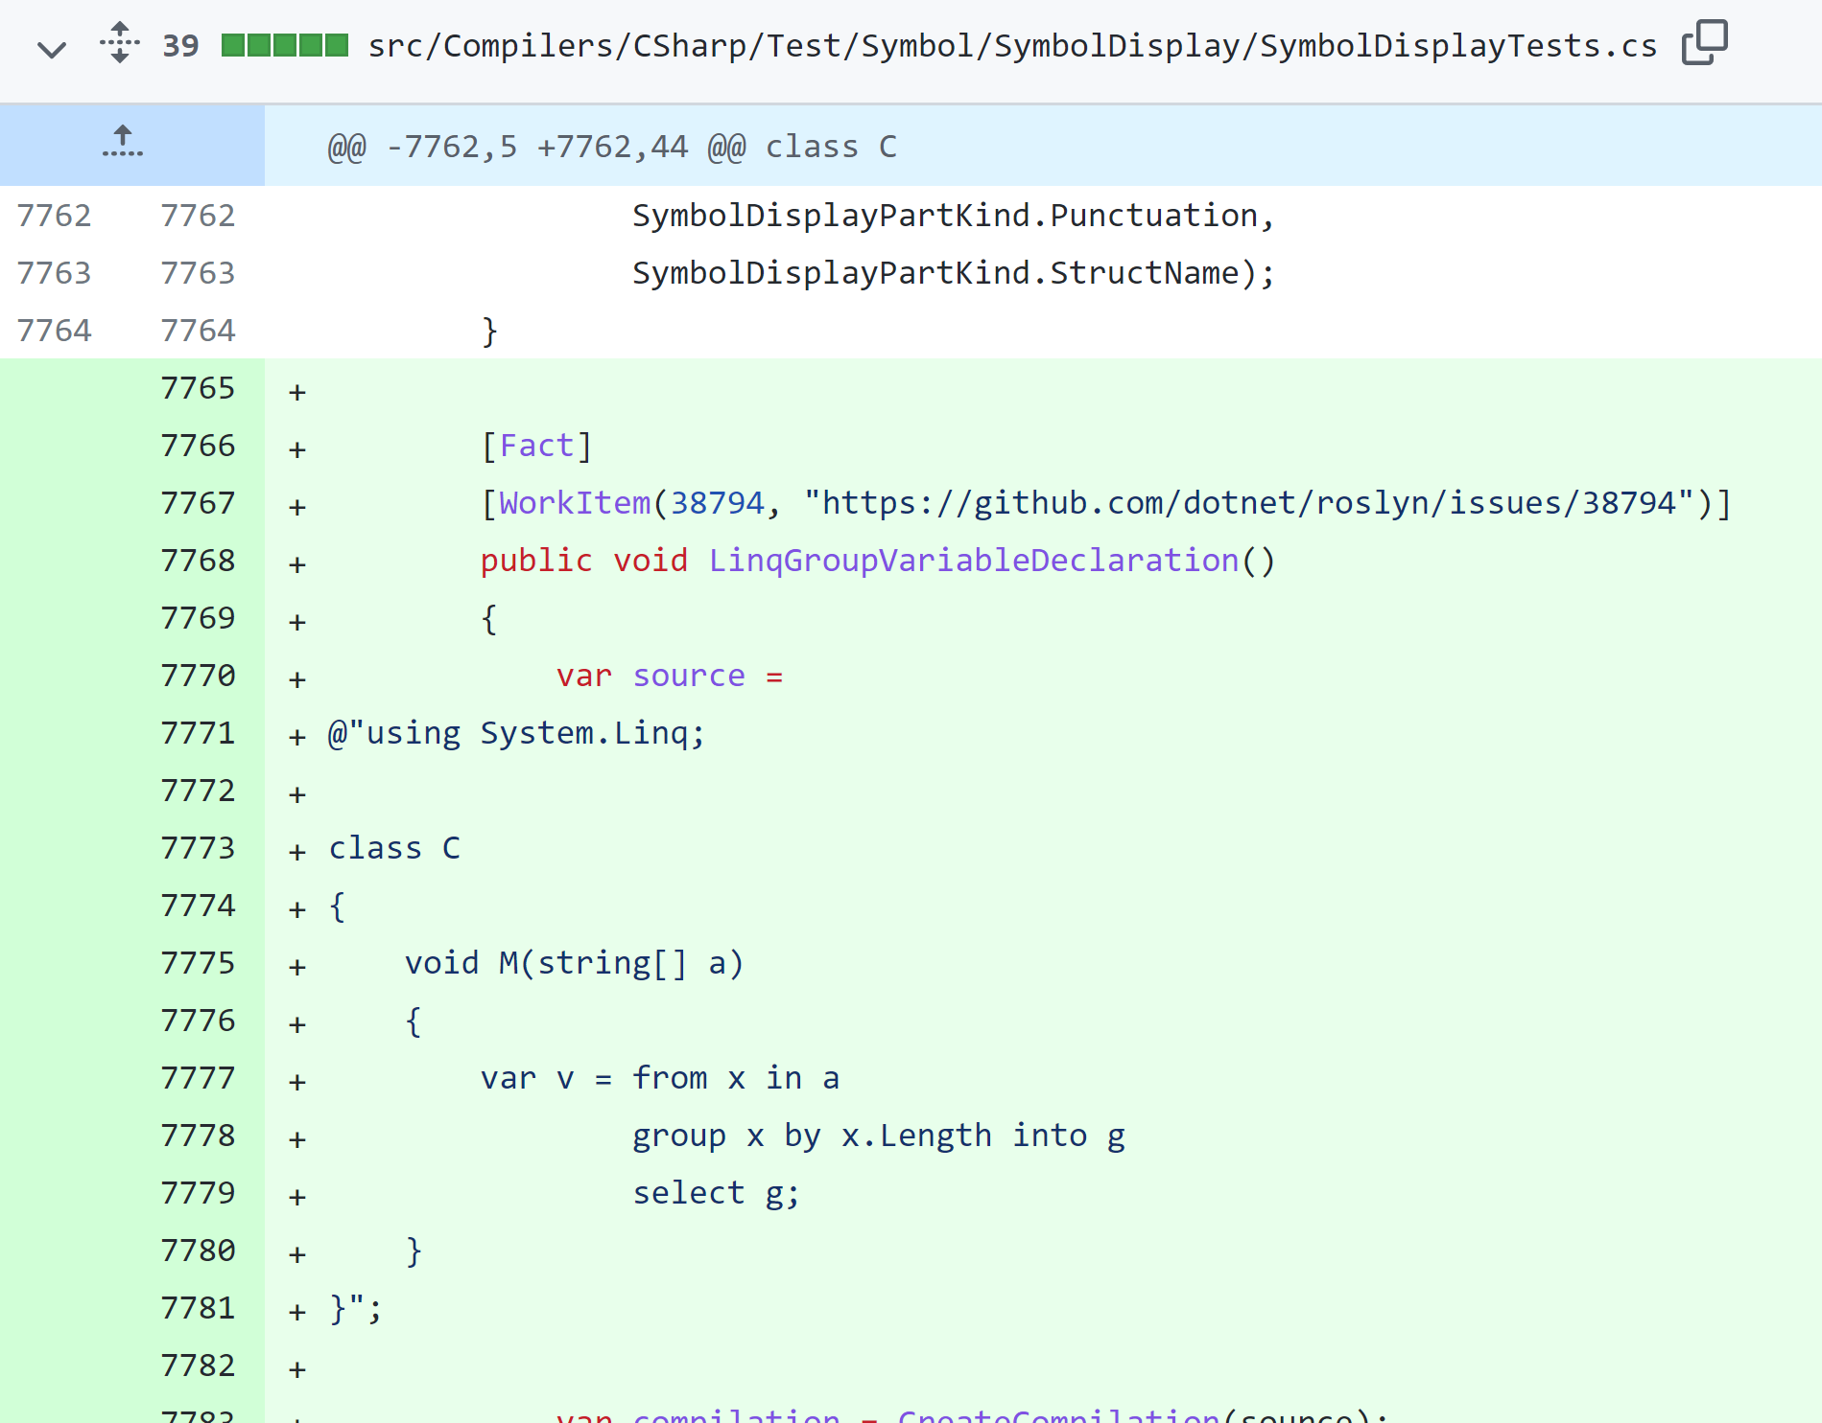

Slide 99
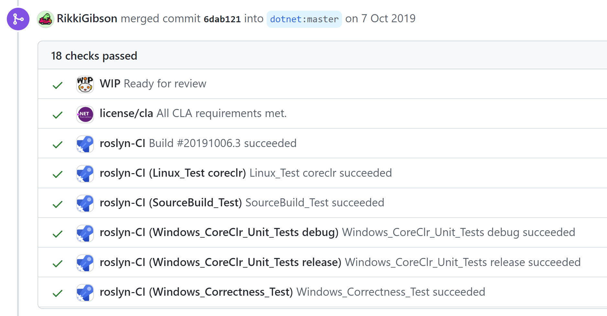

Slide 100
How can one test entire modules?

Slide 101
Testing functions
int sum(int[] vals) { ... }
@Test void sumOf1To3Is6() { ... }

Slide 102
Testing a module
/** Downloads the book with the given ID
* and prints it to the console. */
void printBook(String bookId);

Slide 103


Context
parse

Slide 104
Edge cases
No Internet?
HTTP 404?
Unusual HTML?
...

Slide 105



“End to end” test?

Slide 106
Problems
Implicit input & output

Slide 107
Explicit input
interface HttpClient {
String get(String url);
}

Slide 108
Dependency Injection
void printBook(
String bookId,
HttpClient client
);

Slide 109
Dependency Injection
Code under test
Dependency
Interface

Slide 110
Test
var fakeClient = new HttpClient() {
@Override
public String get(String url) { ... }
}

Slide 111
Production code
printBook( id, new RealHttpClient(...) );

Slide 112
Output
void printBook(
String bookId,
HttpClient client,
ConsolePrinter printer
);

Slide 113
Or...
String getBook(
String bookId,
HttpClient client
);

Slide 114
Test
var result = getBook(...);
// ... Assert ...

Slide 115
Production code
System.out.println(
getBook(...)
);

Slide 116
Adapting code

Slide 117
Example: Network stack
UDP
IP
Data

Slide 118
new UdpClient( new IpClient( new EthernetClient(...) ) );

Slide 119
Left for end-to-end tests
Low-level primitives
“Glue” code

Slide 120
Adapting code

Slide 122
Exercise
Modify and test JokeFetcher.java
+ adapt App.java
First step: Define an HTTP client interface + implement it
Notes:
5min til next

Slide 123
Example: HTTP client
interface HttpClient {
String get(String url);
}
Notes:
Now use the interface in JokeFetcher; 5min

Slide 124
Example: Signature
String getJokeText(
String jokeId,
HttpClient client
);
Notes:
Now write tests; 5min

Slide 125
Example: Fake client
var fakeClient = new HttpClient() {
@Override
public String get(String url) { ... }
}

Slide 126
“Mocks”
var client = mock(HttpClient.class);
when(client.get(anyString())) .thenReturn("Hello");

Slide 127


“Mocks”
ScalaMock
Moq

Slide 128

“End to end” example

Slide 129


Slide 130
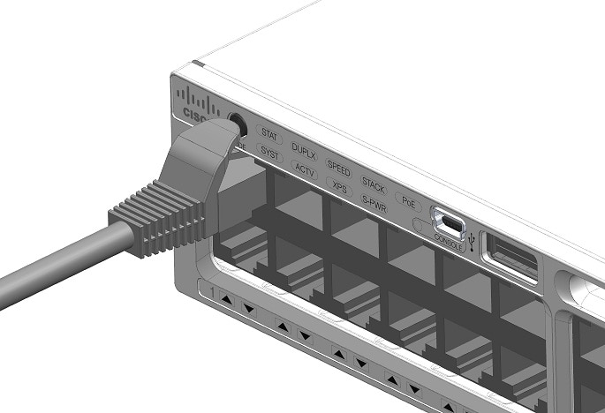
https://www.cisco.com/c/en/us/support/docs/field-notices/636/fn63697.html

Slide 131
End-to-end

Slide 132
Test
main("--upload","file.txt")
0

Slide 133
Stress testing

Slide 134

Smoke testing

Slide 135
Other kinds of tests
Performance
Accessibility
Acceptance
...

Slide 136
Summary
Automated testing: Java basics, good practices, adapting code
Code coverage: statement, branch, path
Testing timeline: TDD, regression tests

